Slide 1
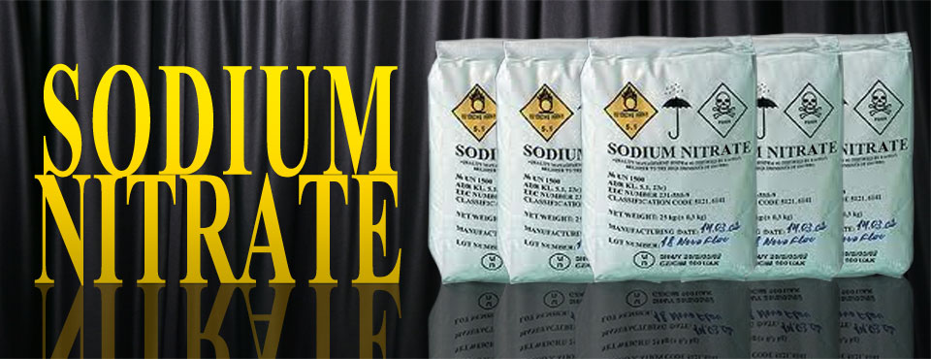
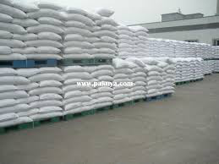
Sodium Nitrite
Sodium Nitrate/Nitrite
By Zac Cummins and Matt Marsala

Slide 2
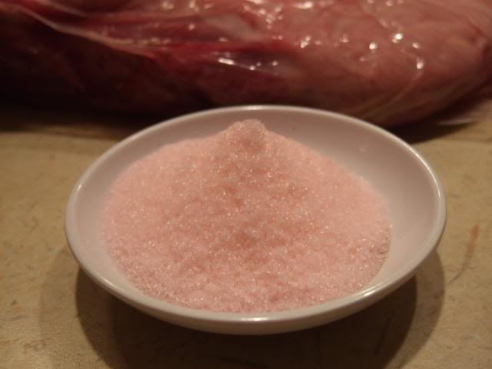
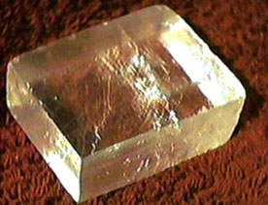
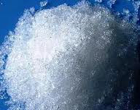
Sodium Nitrate/Nitrite
“Sodium Nitrite is an odorless, yellowish white, crystalline (sand-like) granule, rod or powder. It is used in heat transfer salts, metal treatment and finishing, as a color fixative and preservative for meats, in pharmaceuticals, and as an antidote for Cyanide poisoning.”

Slide 3
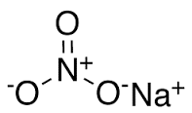
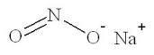
Chemical Structure
Sodium Nitrite
Sodium Nitrate

Slide 4
What’s the Controversy Behind Sodium Nitrates and Nitrites?
The use of nitrates in food preservation is controversial. This is due to the potential for the formation of nitrosamines when nitrates are present in high concentrations and the product is cooked at high temperatures.
The effect is seen for red or processed meat, but not for white meat or fish.
The production of carcinogenic nitrosamines can be potently inhibited by the use of the antioxidants Vitamin C (usually in the form of sodium ascorbate) and the alpha-tocopherol form of Vitamin E during curing.
Under simulated gastric conditions, nitrosothiols rather than nitrosamines are the main nitroso species being formed.
The usage of either compound is therefore regulated; for example, in the United States, the concentration of nitrates and nitrites is generally limited to 200 ppm or lower.
They are considered irreplaceable in the prevention of botulinum poisoning from consumption of cured dry sausages by preventing spore germination.

Slide 5
Chemical Metabolism
In vivo conversion of nitrates to nitrites significantly enhances nitrates' toxic potency. The major metabolic pathway for nitrate is conversion to nitrite, and then to ammonia.
Approximately 5%–10% of the total nitrate intake is converted to nitrite by bacteria in the saliva, stomach, and small intestine.
This reaction is pH dependent, with no nitrate reduction occurring below pH 4 or above pH 9. This is the main reason why infants are more susceptible to nitrite toxicity from elevated nitrate/nitrite ingestion.
Nitrites also react directly with hemoglobin in human blood and other warm-blooded animals to produce methemoglobin. Methemoglobin destroys the ability of red blood cells to transport oxygen. This condition is especially serious in babies under three months of age. It causes a condition known as methemoglobinemia or "blue baby syndrome". Water with nitrite levels exceeding 1.0 mg/L should not be used for feeding babies.
Another potential metabolic pathway is the reaction of nitrite with endogenous molecules to form N-nitroso compounds, which may have toxic or carcinogenic effects.

Slide 6
The “Bare Bones” of this Compound
Nitrogen gas (N₂) is the Earth’s most abundant element.
About 80 percent of the air we breath is nitrogen.
It is found in the cells of all living things and is a major component of proteins.
Inorganic nitrogen may exist in the free state as a gas (N₂), or as a nitrate (NO₃-), nitrite (NO₂-), or ammonia (NH₃+).

Slide 7
Chemical Properties
The half-life for nitrate is 5-6 hours, but it does not accumulate in the body.
The half life for nitrite is 20 minutes.
As a gas, nitric oxide has an extremely short half-life (less than one second), but during that short time it can activate a number of enzymes which cause NO-mediated effects that can last for several hours ( ie)vasodilation ).
Any NO that is not used immediately in a biologic process is rapidly converted back to nitrite and nitrate.
The metabolic steps in the nitrogen cycle depend heavily on bacteria (different metabolic pathways).

Slide 8
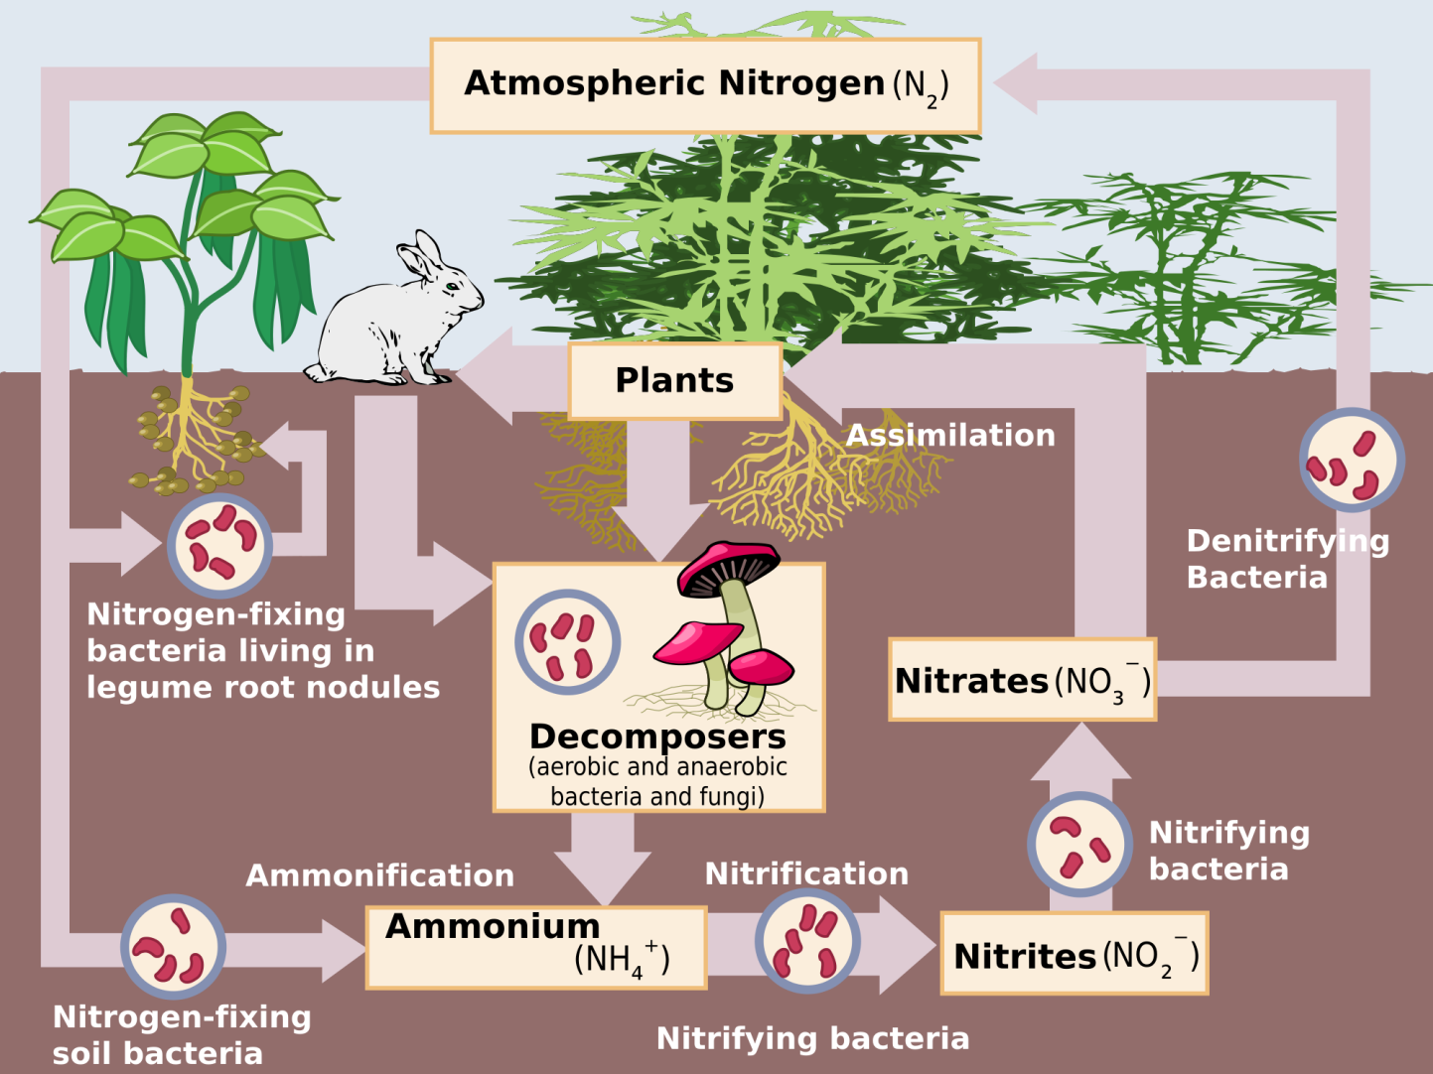
The Nitrogen Cycle

Slide 9
Sources of Sodium Nitrates & Nitrites
Likely exposure pathways for humans include:
Ingesting contaminated drinking water (most commonly of concern for private wells).
Consuming foods containing preservatives (particularly cured meats such as hot dogs and lunch meats to preserve the color, prevent fats from going rancid, and stop bacteria from growing).
Nitrates have also been detected in fruits and vegetables .
Can be inhaled or absorbed through the skin.

Slide 10
More Sources of Sodium Nitrates
Fertilizer use can affect the amount of nitrate in vegetables.
Green leafy vegetables and root plants typically contain the most sodium nitrate.
Vegetables high in sodium nitrate include beets, cabbage, carrots, celery, radishes and spinach.
Around 90 percent of the nitrite in your body comes from vegetables, while just 10 percent comes from processed meats.

Slide 11
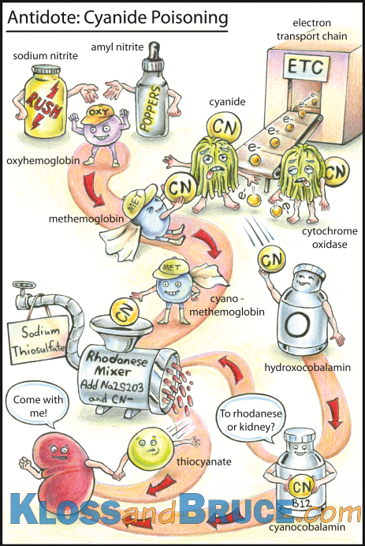
Medical Uses of Sodium Nitrate
“Sodium nitrite, a naturally occurring chemical and common meat preservative, is only used medically to treat cyanide poisoning. But if the results of a new animal study hold up under further research in people, the chemical may one day be used to protect and preserve tissue and organ function after heart attack, high risk abdominal surgery, and organ transplantation.”

Slide 12
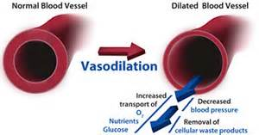
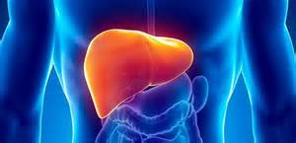
Medical Uses Continued…
“The scientists found that low concentrations of sodium nitrite had a strong protective effect — preventing cell death in the hearts and livers of mice undergoing experimental heart attack and liver injury. In the heart study, nitrite reduced the size of the area of dead tissue known as an infarct by 67 percent compared to control animals given nitrate, another nitrogen compound. This potent protective effect was observed at concentrations of nitrite in blood that were only slightly higher than the physiological normal levels in blood.”

Slide 13
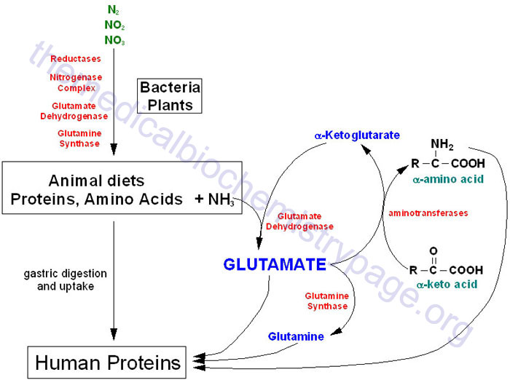
Nitrogen Metabolism

Slide 14
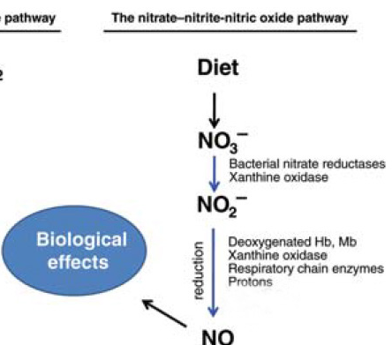
Nitrogen Metabolism (cont’d)

Slide 15
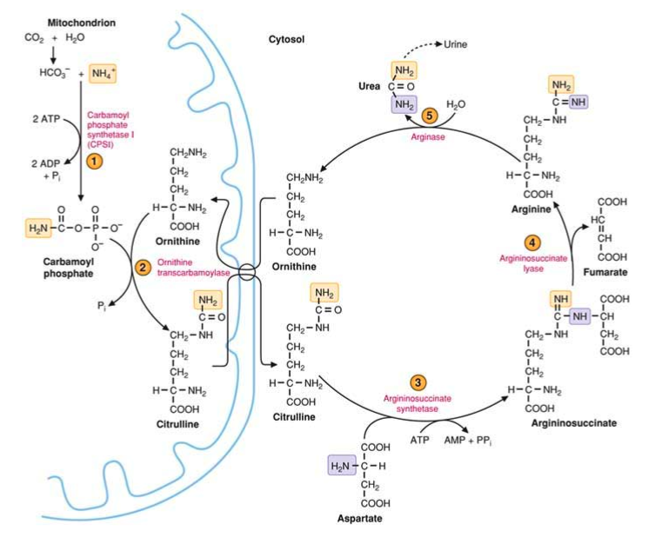
The Urea Cycle

Slide 16
Elimination & Toxicology
Approximately 60% of oral nitrate is excreted in urine. The fate of the rest is not completely known, but bacterial or endogenous metabolism probably accounts for the remainder. A minor part is excreted in sweat.
There are no reports that suggest that sodium nitrate as such has toxicological effects. The main toxicological concern is associated with its conversion to nitrite before or after reaching the human body in sweat.
The major acute toxic effect from nitrite is development of methahemoglobinemia, a condition where more than 10% of the hemoglobin is transformed into methahemoglobin.
When the conversion exceeds 70% the condition can be fatal.
Nitrite may also cause sudden fall in blood pressure due to its vasodilating properties, but these effects are reversible.

Slide 17
Harmful Effects of Nitrites/Nitrates
Nitrates have been shown to have a direct relationship to colon cancer.
Nitrates have been shown to cause pancreatic cancer in rodents.
Dietary Nitrate have been shown to cause thyroid cancer.
Dietary Nitrate has been shown to cause birth defects in children.
Contact can irritate skin and eyes.
Inhalation can cause irritation in the nose and throat.
Can cause headache, nausea, vomiting, diarrhea & abdominal pain.

Slide 18
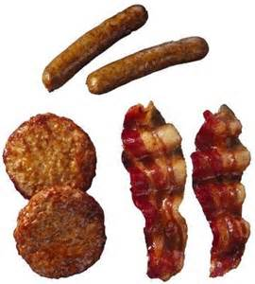
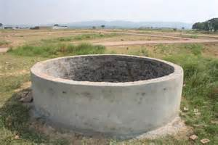
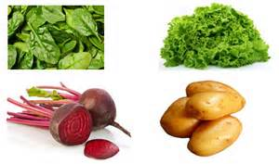
Sodium Nitrite/Nitrate Exposure
Risk for exposure depends on the diet of the individual.
Risk of being exposed to sodium nitrites is elevated in cases of well water, cured meats, smoked meats, certain vegetables from fertilizers. The more ingestion of these specific products, the more an individual will be exposed to the toxin.

Slide 19
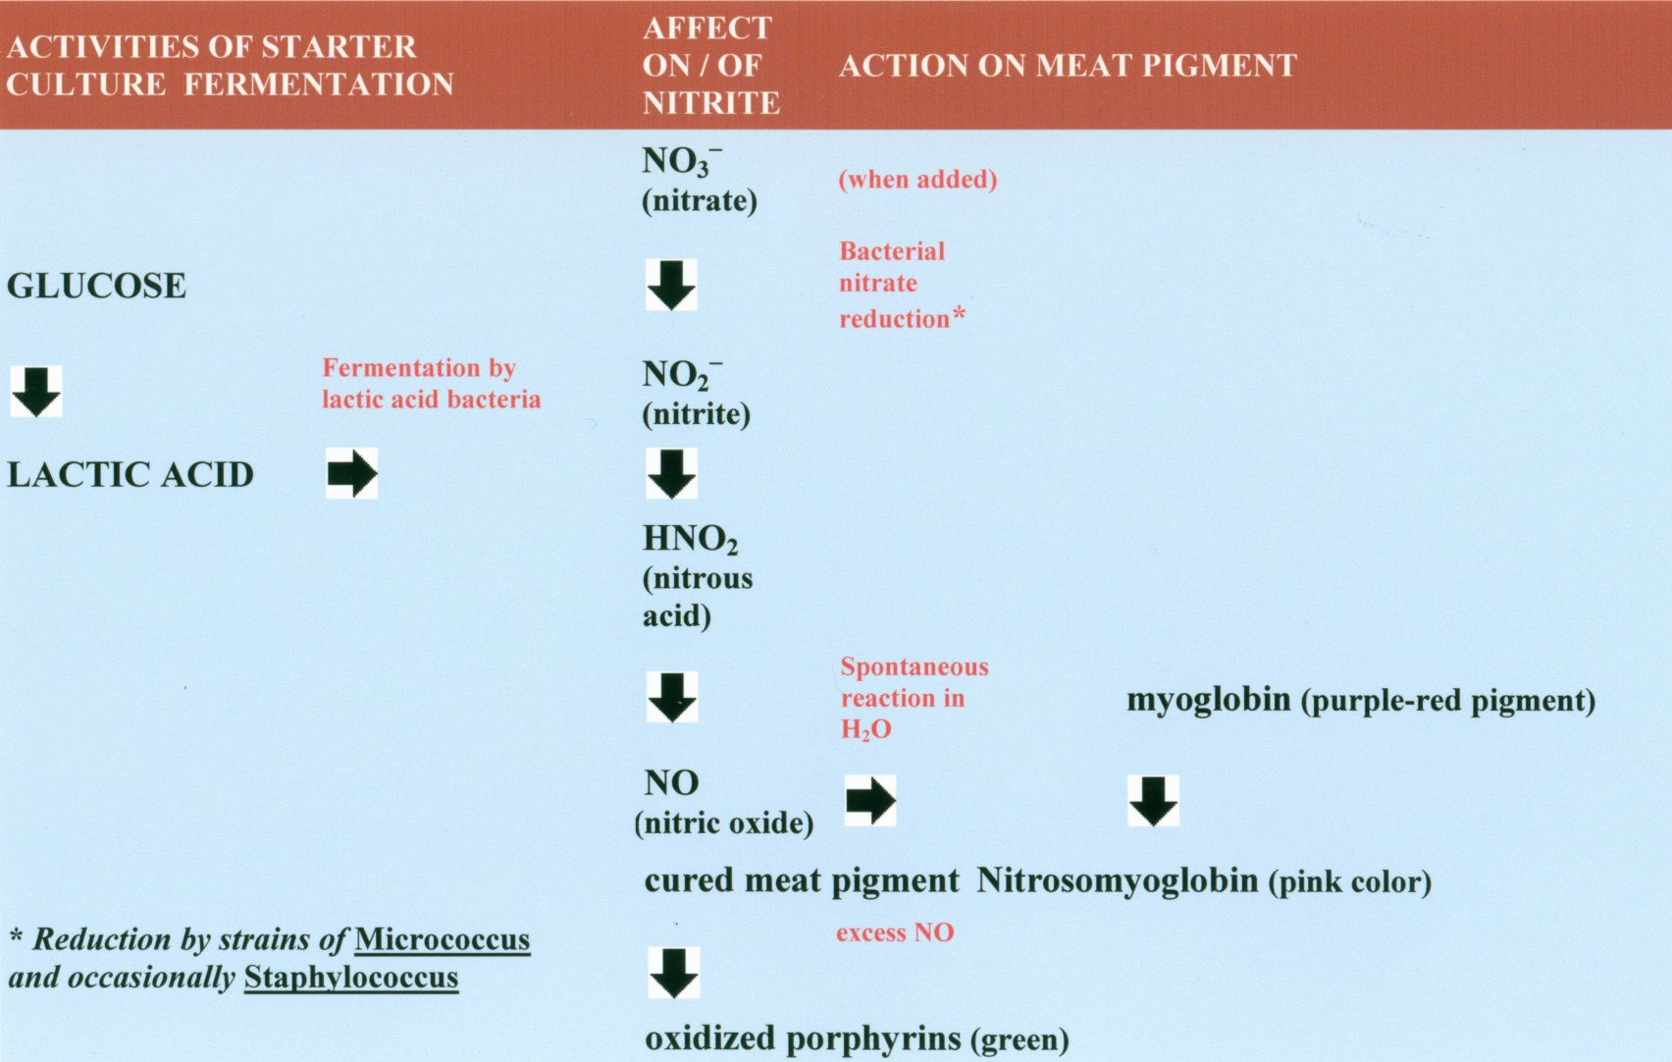
Meat Curing Process

Slide 20
Nitrates in Our Water
Nitrate (NO3-) and nitrite (NO2-) are naturally occurring inorganic ions that are part of the nitrogen cycle.
Microbial action in soil or water decomposes wastes containing organic nitrogen into ammonia, which is then oxidized to nitrite and nitrate.
Water naturally contains less than 1 milligram of nitrate-nitrogen per liter and is not a major source of exposure. Higher levels indicate that the water has been contaminated.
Common sources of nitrate contamination include fertilizers, animals wastes, septic tanks, municipal sewage treatment systems, and decaying plant debris.
State and federal laws set the maximum allowable level of nitrate-nitrogen in public drinking water at 10 mg/L (10 parts per million).
Nitrification is the conversion of ammonia (NH3+) to nitrate (NO3-). Denitrification is the conversion of nitrate (NO3-) to nitrogen gas (N2).

Slide 21
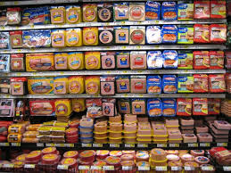
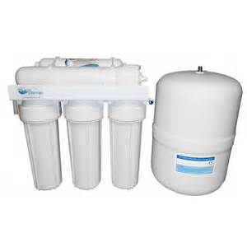
Care Management
The best way to eliminate the threat from sodium nitrites and nitrates is to minimize your exposure and avoid major sources of these compounds.

Slide 22
How to Avoid Nitrates
Read labels!!!
Minimize consumptions of processed foods and cured meats.
Eat organic foods not grown with synthetic nitrogen fertilizers.
Eat a diet high in antioxidants. (Certain vitamins, like vitamin C can reduce the conversion of nitrate).
Use a home water distiller or reverse osmosis filter.

Slide 23
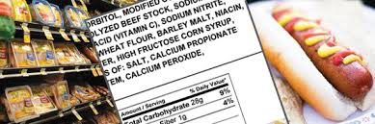
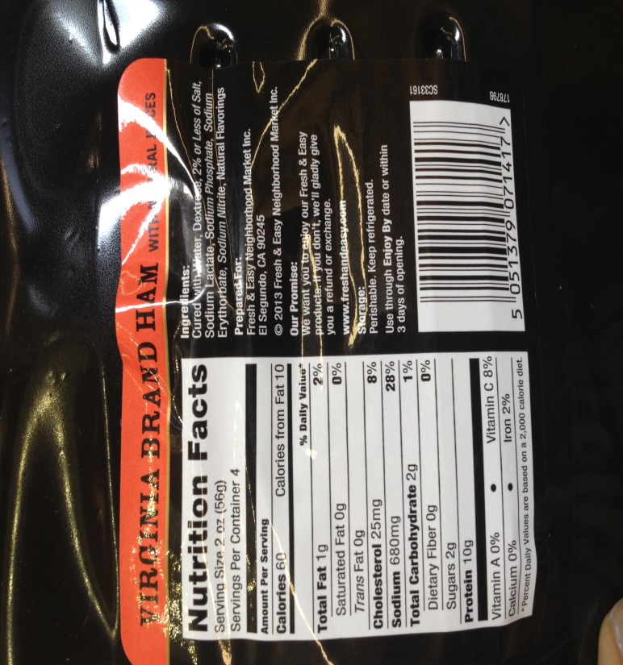
Identifying on Labels

Slide 24
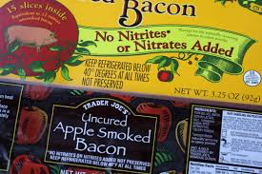
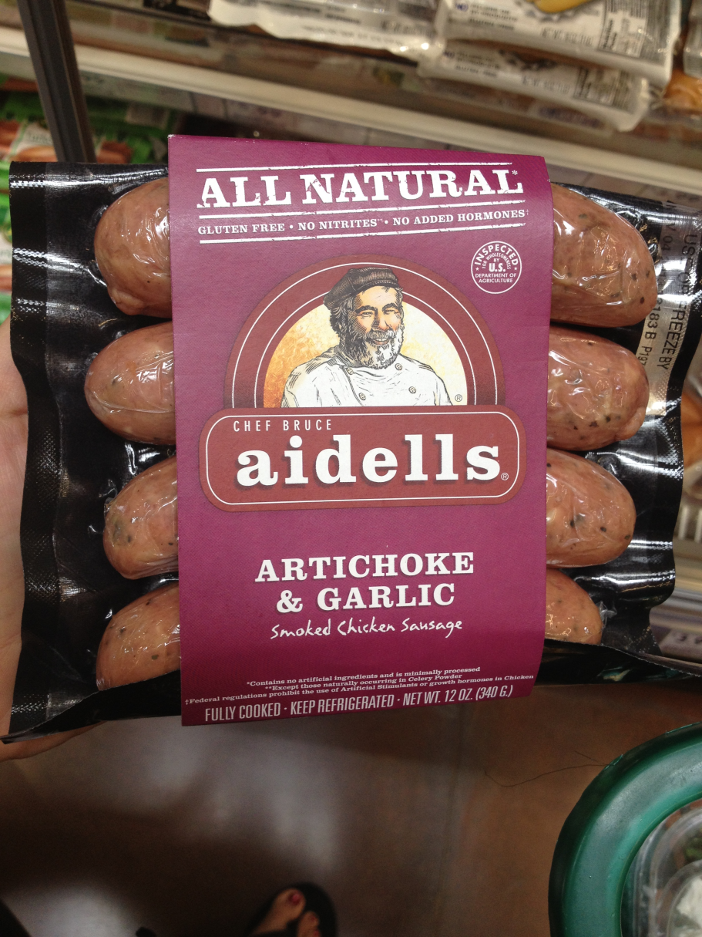
What to Look for

Slide 25
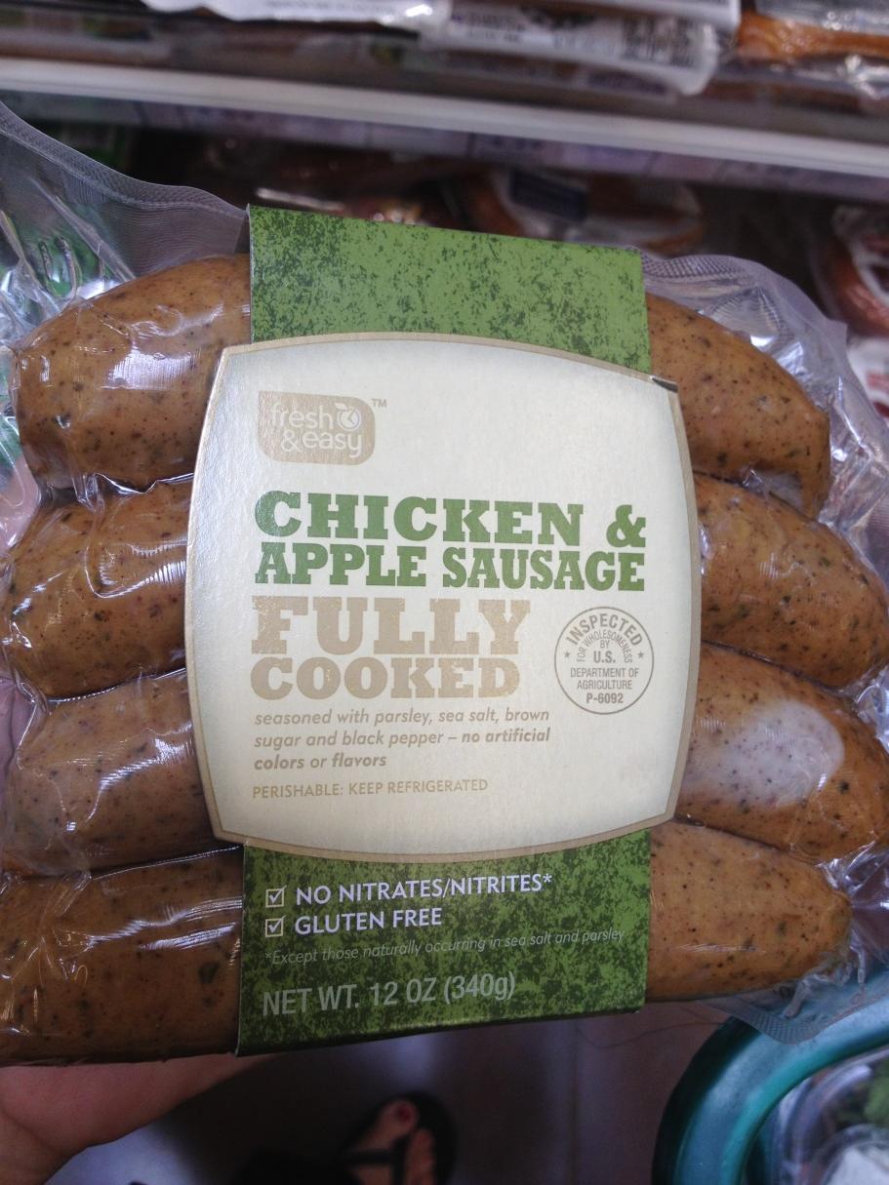
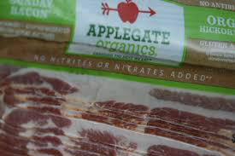
What to Look for (Cont.)

Slide 26
Conclusion
Nitrates may have some medical benefits in crisis care cases, but in everyday life, they should be minimized due to possible carcinogenicity.
Looking for labeling of products to check ingredients is extremely useful.
Supplement with Vitamins C and E or eat foods high in these antioxidants.
Reverse osmosis water filters are the best way to prevent sodium nitrite/nitrate exposure from water sources.

Slide 27
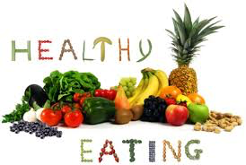

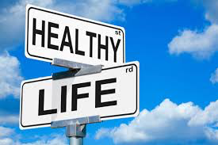
Thank You!

Slide 28
References
"Environmental Health and Medicine Education." Nitrate/Nitrite Toxicity: Key Concepts. N.p., n.d.. Web. 12 Sept. 2013. <http://www.atsdr.cdc.gov/csem/csem.asp?csem=9>
Aschebrook-Kilfoy, Cross, Stolzenberg-Solomon, Schatzkin, Hollenbeck, Sinha, Ward. (2011). Pancreatic Cancer and Exposure to Dietary Nitrate and Nitrite in the NIH-AARP Diet and Health Study. American Journal of Epidemiology, Volume 174 (3), pgs. 1-11
Huber, Brender, Zheng, Sharkey, Vuong, Shinde, Griesenbeck, Suarez, Langlois, Canfield, Romitti, Weyer. Maternal dietary intake of nitrates, nitrites, nitrosamines and selected birth defects in offspring: a case control study. Nutrition Journal, Volume 12:34, pgs. 1-10
Kilfoy, Zhang, Park, Holford, Schatzkin, Hollenbeck, and Ward. (2011). Dietary Nitrate and Nitrite and the risk of thyroid cancer in the NIH-AARP Diet and Health Study. Int J Cancer, Volume 129(1), pgs.1-21 a
Miller, Lazarus, Lesko, Cross, Sinha, Laio, Zhu, Harper, Muscat, Hartman. (2013). Meat-Related Compounds and Colorectal Cancer Risk by Anatomical Subsite. Nutr Cancer, Volume 65(2), pgs. 1-36.
"New Medical Uses for Sodium Nitrite for Heart Attack and OrganDamage, April 14, 2005 Press Release - National Institutes of Health(NIH)." U.S National Library of Medicine. U.S. National Library of Medicine, n.d. Web. 10 Sept. 2013.
"Sodium Nitrite: The Facts." Meatami.com. N.p., n.d. Web. <http://www.meatami.com/ht/a/GetDocumentAction/i/44170>.
Supporting References and Summaries Are Provided in the TEACH Database at Http://www.epa.gov/teach/ . Last Revised 5/22/07: Includes Research Artic Les and Other Information through 2006. Page 1 Nitrates and Nitrites TEACH Chemical Summary. EPA, n.d. Web. <http://www.epa.gov/teach/chem_summ/Nitrates_summary.pdf>.
Hazardous Substance Fact Sheet. Trenton, NJ: Dept., n.d. Web. 28 Feb. 2015.
Jakszyn, P.; Gonzalez, C. A. (2006). "Nitrosamine and related food intake and gastric and oesophageal cancer risk: A systematic review of the epidemiological evidence". World journal of gastroenterology : WJG 12 (27): 4296–4303. PMC 4087738. PMID 16865769. Accessed February 12, 2015

Slide 29
References (cont’d)
De Vries, John (1997). Food Safety and Toxicity. CRC Press. p. 70. ISBN 978-0-8493-9488-1.
Charles, R. L.; Rudyk, O.; Prysyazhna, O.; Kamynina, A.; Yang, J.; Morisseau, C.; Hammock, B. D.; Freeman, B. A.; Eaton, P. (2014). "Protection from hypertension in mice by the Mediterranean diet is mediated by nitro fatty acid inhibition of soluble epoxide hydrolase". Proceedings of the National Academy of Sciences 111 (22): 8167. doi:10.1073/pnas.1402965111.
V. M. Ivanov (2004). "The 125th Anniversary of the Griess Reagent". Journal of Analytical Chemistry 59 (10): 1002–1005. doi:10.1023/B:JANC.0000043920.77446.d7. Translated from V. M. Ivanov (2004). Zhurnal Analiticheskoi Khimii 59 (10): 1109–1112.
Ascorbate-nitrite reaction: possible means of blocking the formation of carcinogenic N-nitroso compounds". Science 177 (4043): 65–8. July 1972. Bibcode:1972Sci...177...65M. doi:10.1126/science.177.4043.65. PMID 5041776.
"Effects of vitamins C and E on N-nitroso compound formation, carcinogenesis, and cancer". Cancer 58 (8 Suppl): 1842–50. October 1986. doi:10.1002/1097-0142(19861015)58:8+<1842::aid-cncr2820581410>3.0.co;2-#. PMID 3756808.
Honikel, K. O. (2008). "The use an control of nitrate and nitrite for the processing of meat products". Meat Science 78: 68–76. doi:10.1016/j.meatsci.2007.05.030.
Absence of volatile nitrosamines in human feces". Cancer Res. 41 (10): 3992–4. October 1981. PMID 7285009.
"Does increased endogenous formation of N-nitroso compounds in the human colon explain the association between red meat and colon cancer?". Carcinogenesis 17 (3): 515–23. March 1996. doi:10.1093/carcin/17.3.515. PMID 8631138.
"Diet-induced endogenous formation of nitroso compounds in the GI tract". Free Radic. Biol. Med. 43 (7): 1040–7. October 2007. doi:10.1016/j.freeradbiomed.2007.03.011. PMID 17761300.

